Slide 1

Evaluating Fruit Quality Using Deep Learning
Project Guide: | 126015083 | Shivanand Racha
Dr.Nithya R | 126015082 | Phaneendra Bosu
Asst.Professor III | 126015000 | Anirudh Laukhik

Slide 2

Table of Contents
Abstract
Objective
Base Paper
Problem Statement
Literature survey
Modules
Dataset
Work Plan
Proposed Techniques
References

Slide 3
Abstract
This study focuses on developing an AI-driven system for real-time fruit freshness detection to minimize food waste and improve quality control.
Machine learning models are utilized to enable predictive maintenance, allowing better forecasting of fruit shelf life and optimizing storage conditions.
Advanced deep learning techniques are applied to detect early signs of fruit decay, enhancing sorting efficiency and reducing spoilage.
AI-powered decision-making supports intelligent supply chain management, ensuring optimal inventory control and reducing unnecessary losses.
Energy efficiency is improved by identifying inefficiencies in storage and transportation, leading to reduced resource consumption.
AI-based freshness monitoring helps maintain ideal conditions, extending the shelf life of fruits and preventing premature deterioration.
A robust dataset and AI models ensure accurate anomaly detection, enhancing food safety and maintaining consumer trust in fruit quality.

Slide 4
Objectives
Real-Time Anomaly Detection : hybrid models enable faster, more accurate fruit freshness detection.
Predictive Maintenance : Multi-modal approaches and optimize storage and shelf-life estimation.
Optimized Quality Assessment : Advanced feature engineering and ensemble learning improve classification accuracy.
AI/ML-Driven Decision-Making : Explainable AI techniques enhance transparency in fruit quality assessment.
Energy Efficiency : Real-time edge optimizations reduce energy consumption in sorting and storage.
Consumer Trust & Safety : A diverse dataset and multi-task learning ensure reliable freshness evaluation.
Increased Shelf Life : AI-driven freshness monitoring helps maintain optimal conditions, extending fruit longevity.

Slide 5

Base paper
Olusola O. Abayomi‑Alli1 · Robertas Damaševičius1 · Sanjay Misra2 · Adebayo Abayomi‑Alli3 Received: 9 January 2023 / Revised: 18 March 2023 / Accepted: 18 June 2023 / Published online: 28 June 2023 © The Author(s), under exclusive licence to Springer Science+Business Media, LLC, part of Springer Nature 2023
Indexed in: SCIE
Year : 2023
Link : https://link.springer.com/article/10.1007/s11042-023-16058-6

Slide 6
Problem Statement
Traditional fruit freshness evaluation methods are subjective, labor-intensive, and inconsistent, leading to food waste, supply chain inefficiencies, and consumer dissatisfaction. Current automated solutions lack real-time decay detection, predictive maintenance, and optimized decision-making, resulting in inaccurate assessments and poor resource use. This study proposes an AI-driven system using advanced machine learning to detect early decay, optimize storage, improve energy efficiency, extend shelf life, and ensure food safety, addressing these challenges through real-time monitoring, predictive analytics, and AI-powered decision-making.

Slide 7
Literature survey
YEAR | AUTHOR | TITLE | METHODS | ACCURACY
2021 | Arnav Kumar, Rakesh Chandra Joshi, Malay Kishore Dutta, Martin Jonak, Radim Burget | Fruit-CNN: An Efficient Deep Learning-Based Fruit Classification and Quality Assessment | Optimized Convolutional Neural Network (CNN) | 98.3%
2022 | Md. Samin Morshed, Sabbir Ahmed, Tasnim Ahmed, Muhammad Usama Islam, A. B. M. Ashikur Rahman | Fruit Quality Assessment with Densely Connected | Convolutional Neural Network, DenseNet | 98.67%
2022 | Bhumica Dhiman, Yogesh Kumar, Munish Kumar | Fruit Quality Evaluation Using Machine Learning Techniques: Review, Motivation, and Future Perspectives | Random Forest, Gradient Boosting, CNNs | 95.67%
2023 | M. Karthikeyan, T. S. Subashini, R. Srinivasan, C. Santhanakrishnan, A. Ahilan | Automated Fruit Quality Recognition Using YOLOv3 and Deep Learning | YOLOAPPLE (YOLOv3 + Darknet53 + Spatial Pyramid Pooling) | 97.3%

Slide 8
Literature survey
YEAR | AUTHOR | TITLE | METHODS | ACCURACY
2023 | Ioannis D. Apostolopoulos, Mpesi Tzani, Sokratis I. Aznaouridis | A General machine Learning Model for Assessing Fruit Quality Using Deep Image Features | Vision Transformerrs(ViT) | 98.8%
2024 | Víctor Zárate, Danilo Cáceres Hernández | Deep Learning-Based Fruit Quality Detection for Sustainable Agriculture | Convolutional Neural Networks (CNNs) | 98.2%
2024 | Víctor Zárate, Danilo Cáceres Hernández | Simplified Deep Learning for Accessible Fruit Quality Assessment in Small Agricultural Operations | CNN trained from scratch, MobileNetV2 (fine-tuned) | 97.5%
2025 | P. Sumari, W.M.A. Wan Ahmad, F. Hadi, M. Mazlan, N.A. Liyana, R.-W. Bello, A.S.A. Mohamed, A.Z. Talib | Hybrid Deep Learning Model for Fruit Classification and Quality Prediction Using CNNs and OpenCV | Optimized Convolutional Neural Network (CNN) | 94.99%

Slide 9
Modules
Module 1: Data Processing & Feature Selection
Dataset Creation
Preprocessing
EDA
Module 2: Classification Algorithms (CNN-based Models)
ShuffleNet
SqueezeNet
EfficientNet B0
ResNet-50
MobileNet

Slide 10
Data Set
Link :
https://www.kaggle.com/datasets/sriramr/fruits-fresh-and-rotten-for-classification

Slide 11
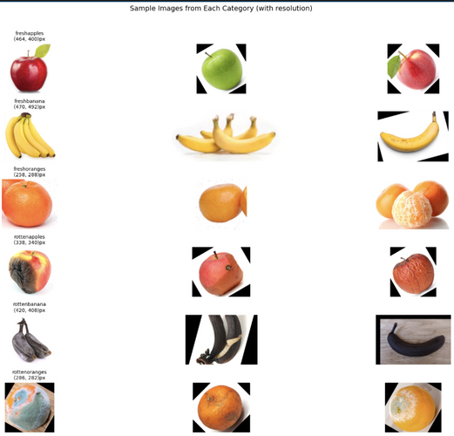
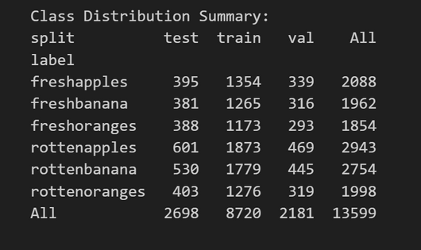
Data Set Details :

Slide 12
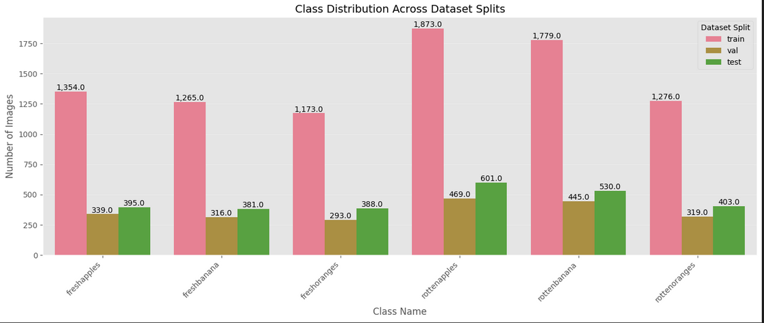
Data Set Details :

Slide 13
Dataset Used:
Fruits fresh and rotten for classification
Purpose: To find freshness and to evaluate shelf time of the fruit
Features: Contains images of apples from different angles, different variations, and classified according to freshness
Use Case: Widely used for predicting fruit quality using deep learning with convolutional neural networks

Slide 14
Methodology
1.Data Collection & Preprocessing
*Fruit images from FruitQ & FruitNet datasets
*De-watermarking, frame extraction, resizing
2. Dataset Preparation
*Train, Validation, Test Split
3. Feature Selection & Extraction
*RGB & HSV Analysis, Texture Features
*Outlier Detection & Augmentation
4. Classification Models
*CNNs: ShuffleNet, SqueezeNet, EfficientNet, ResNet-18, MobileNet-V2
*CNN-Hybrid
5. Model Training & Evaluation
*Metrics: Accuracy, Precision, Recall, F1-Score
*Dataset & Model Comparisons
6. Final Prediction
*Real-time anomaly detection & freshness evaluation
*Predictive maintenance for shelf-life

Slide 15
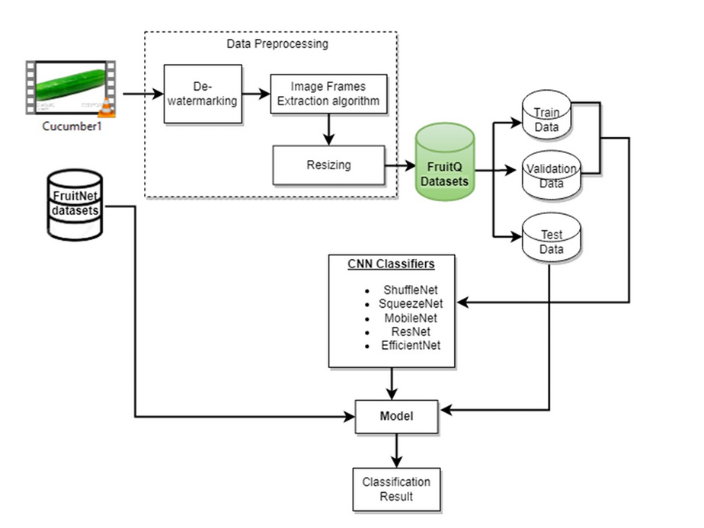
Overall Architecture

Slide 16
1. ResNet18 :
Data Augmentation & Preprocessing :
Training Transformations:
Random resizing and cropping, horizontal flipping.
Converted to tensor and normalized using ImageNet’s mean and std.
Validation/Test Transformations :
Resized and center-cropped, then normalized with no randomness.
Model Setup:
Pre-trained Weights: Loaded from ImageNet.
Final Layer: Replaced with a classifier for your specific dataset.

Slide 17
Model Setup :
Pre-trained Weights: Loaded from ImageNet.
Final Layer: Replaced with a classifier for your specific dataset.
Device: Sent to GPU if available for fast processing.
Training:
Loss Function: CrossEntropyLoss.
Optimizer: Adam.
Epochs: Trained for 10 epochs.
Fine-Tuning :
Initial layers were frozen, and only the newly added classifier was trained.
Fine-tuning allowed ResNet18 to adjust the higher-level feature extraction layers to fit your dataset.
Epochs: 10 epochs of training, allowing the model to converge while retaining learned features.

Slide 18
2. EfficientNetB0 :
Data Augmentation & Preprocessing :
Same transformations applied (random resizing, cropping, and flipping for training; resizing and center-cropping for validation/test).
Model Setup :
Pre-trained Weights: Loaded from ImageNet.
Final Layer: Modified to suit the number of classes in your dataset.
Device: Sent to GPU for efficient computation.

Slide 19
Training :
Loss Function: CrossEntropyLoss.
Optimizer: Adam.
Epochs: Trained for 10 epochs.
Fine-Tuning :
The first few layers were frozen, with only the final classifier and some intermediate layers trained.
EfficientNetB0 adapts well to fine-tuning because its architecture is optimized for transfer learning.
Epochs: 10 epochs, allowing for subtle adjustments to adapt to the new dataset.

Slide 20
3. SqueezeNet1_0 :
Data Augmentation & Preprocessing:
Similar augmentations as the others with random resizing and horizontal flipping for training, and resizing and center-cropping for validation.
Model Setup :
Pre-trained Weights: Loaded from ImageNet.
Final Layer: Replaced with a classifier matching the number of output classes.
Device: Sent to GPU.

Slide 21
Training :
Loss Function: CrossEntropyLoss.
Optimizer: Adam.
Epochs: Trained for 10 epochs.
Fine-Tuning :
Similar to other models, freezing early layers and training the final layer(s) enabled the model to learn features specific to your dataset.
Fine-tuning helped improve performance despite the model being lightweight.
Epochs: 10 epochs for the model to adjust while keeping the core features intact.

Slide 22
4. MobileNetV2 :
Data Augmentation & Preprocessing:
Consistent augmentations as others, with random resizing, cropping, and flipping for training, and resizing and center-cropping for validation/test.
Model Setup :
Pre-trained Weights: Loaded from ImageNet.
Final Layer: Replaced with a classifier for your dataset.
Device: Sent to GPU if available.

Slide 23
Training :
Loss Function: CrossEntropyLoss.
Optimizer: Adam.
Epochs: Trained for 10 epochs.
Fine-Tuning :
Initial layers were frozen to prevent overfitting, with the final classifier layers trained.
The model was adjusted slightly for your dataset while maintaining its lightweight, efficient structure.
Epochs: 10 epochs, with a focus on fine-tuning the output layer to classify your specific dataset.

Slide 24
5. ShuffleNetV2 :
Data Augmentation & Preprocessing:
Same augmentations (random resizing, cropping, and flipping for training; resizing and center-cropping for validation).
Model Setup :
Pre-trained Weights: Loaded from ImageNet.
Final Layer: Replaced with the classifier suited for your dataset.
Device: Sent to GPU if available.

Slide 25
Training :
Loss Function: CrossEntropyLoss.
Optimizer: Adam.
Epochs: Trained for 10 epochs.
Fine-Tuning :
As with the other models, the earlier layers were frozen, and the final layers were fine-tuned for your dataset.
ShuffleNetV2’s compact structure benefited from fine-tuning because it retained generalizable features while adjusting to your specific dataset.
Epochs: 10 epochs for fine-tuning the model’s last layers.

Slide 26

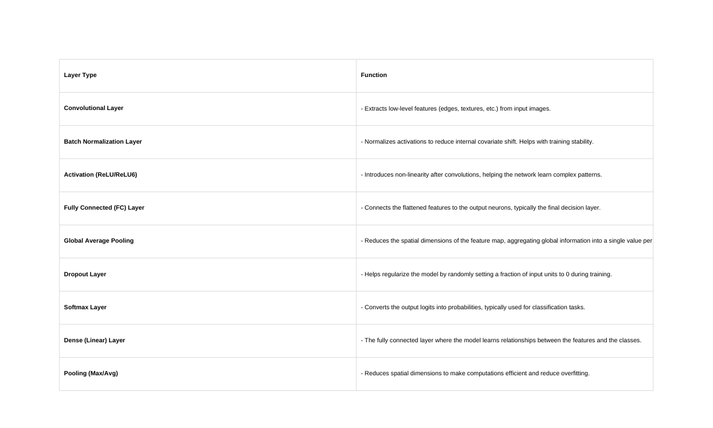
Feature Extraction Block (Convolutional Layers)
.

Slide 27
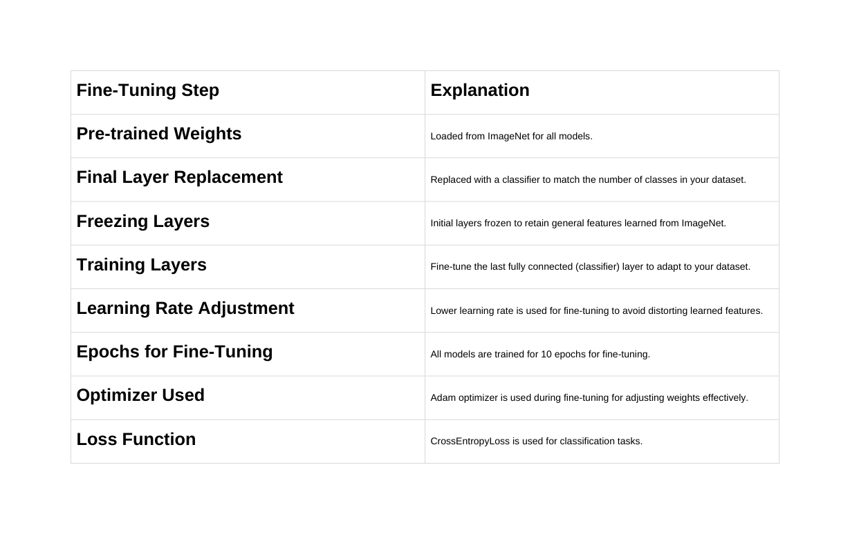
Feature Extraction Block (Convolutional Layers)
.

Slide 28
MODEL EVALUATION
Micro Average :
Treats all classes equally, calculating the total true positives, false positives, and false negatives across all classes.
Weighted Average:
Considers class imbalance, gives more weight to dominant classes.
Accuracy:
Measures the percentage of correct predictions out of total predictions.

Slide 29
2. Precision (Positive Predictive Value):
Measures how many of the predicted positive cases were actually correct.
High precision means fewer false positives.
3. Recall (Sensitivity / True Positive Rate):
Measures how many of the actual positive cases were correctly predicted.
High recall ensures fewer false negatives.
4. F1-Score
Balances precision and recall, especially useful for imbalanced datasets.
High F1-score means both precision and recall are optimized.

Slide 30
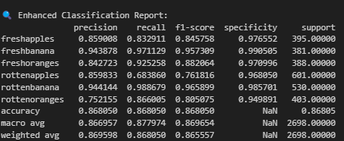
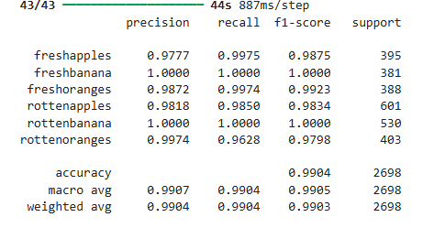
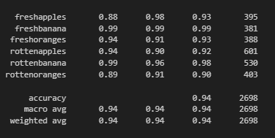
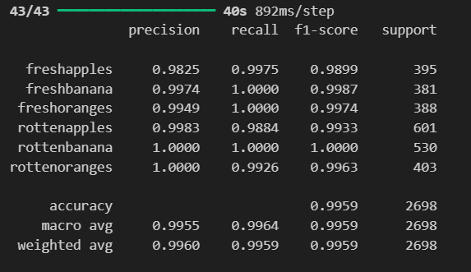
Classification
ResNet50
EfficientNet
SqueezeNet
MobileNet
.

Slide 31
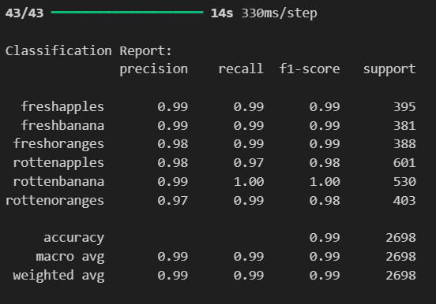
ShuffleNet

Slide 32
Model evaluation and Testing
Architecture | Accuracy (%) ( Predicted) Accuracy (%) (Observed)
ResNet | 86.0 86.8
MobileNet | 99.5 99.8
SqueezeNet | 94.0 94.8
EfficientNet | 98.0 98.6
ShuffleNet | 97.0 97.5

Slide 33
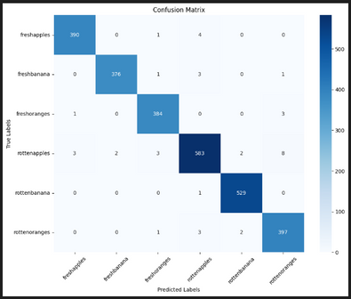
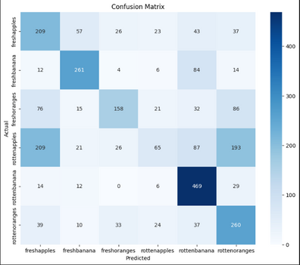
Confusion Matrix
ShuffleNet
ResNet50
.

Slide 34
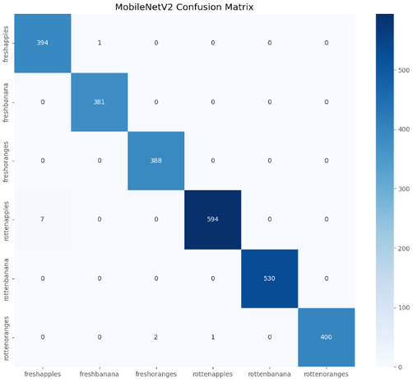
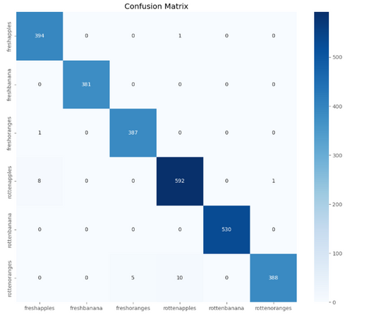
Confusion Matrix
MobileNetV2
EfficientNet
.

Slide 35
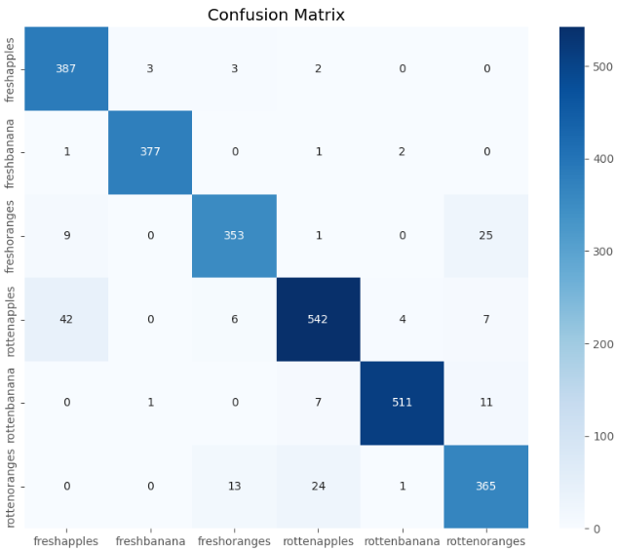
Confusion Matrix
SqueezeNet
.

Slide 36
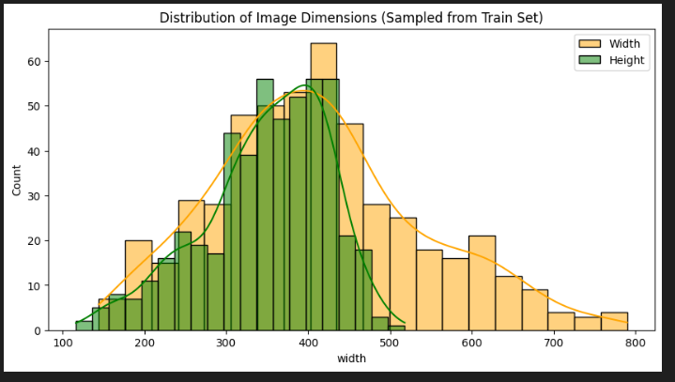
EDA Analysis
.

Slide 37
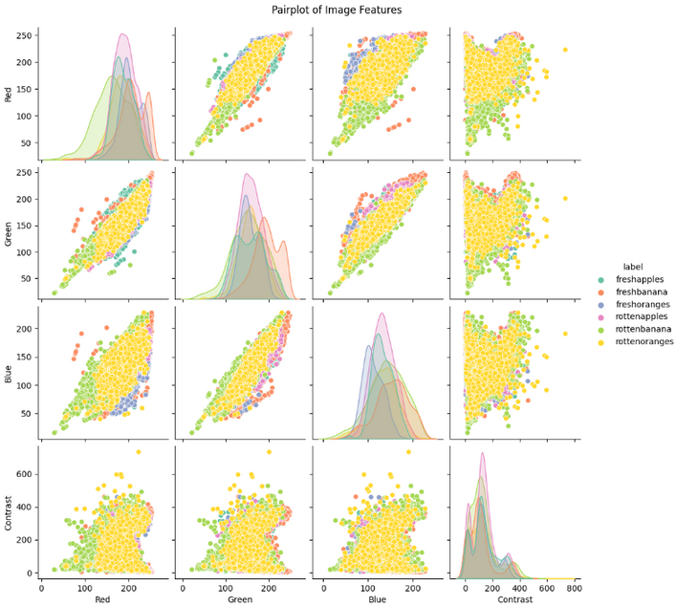
EDA Analysis
.

Slide 38
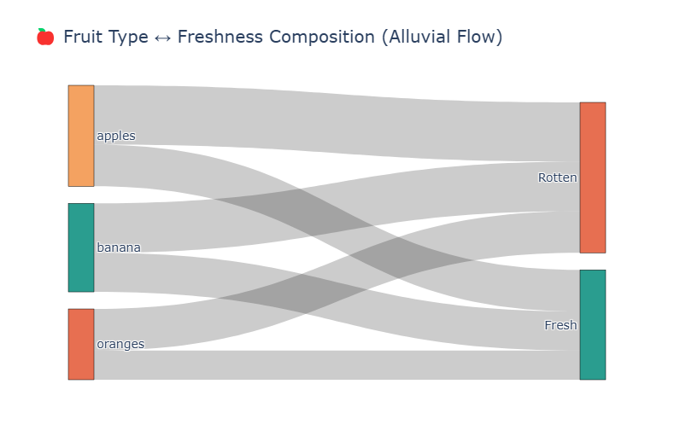
EDA Analysis
.

Slide 39
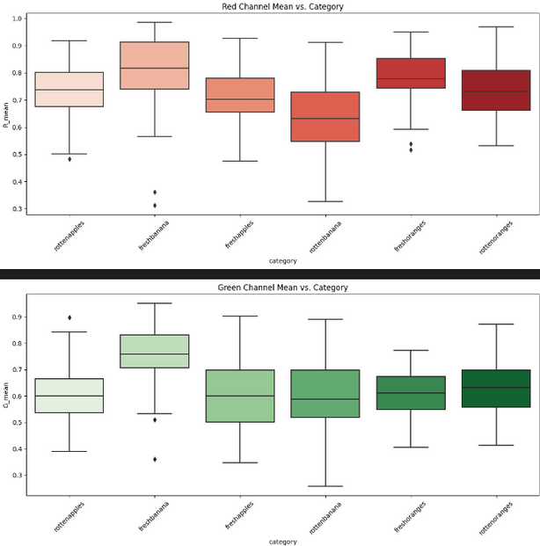
Feature relationship with Target class
.

Slide 40
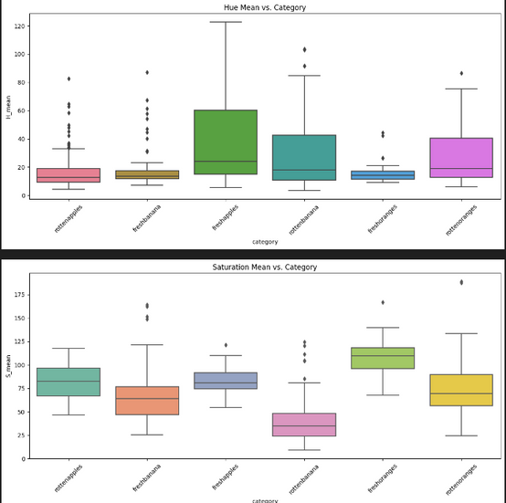
HSV Analysis
.

Slide 41
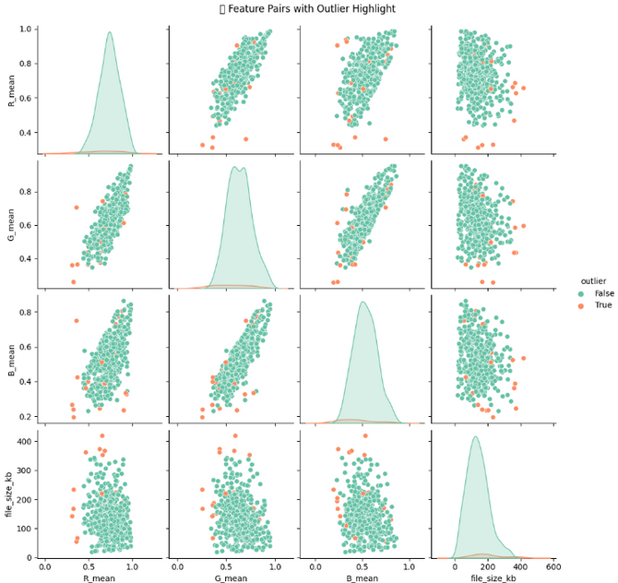
Outlier Analysis
.

Slide 42
Work Plan:
Start : 16/01/2025
Paper Submission : 25/01/2025
Data Collection : 16/01/2025-02/02/2025
Preprocession : 1 week
Model Implementation : 2 Weeks
Evaluation : 2 Weeks
Final Submission Date : 17/04/2025

Slide 43
Conclusion
This study introduces the FruitQ-DB dataset and evaluates fruit freshness using CNN-based models. ResNet-18 achieved the highest accuracy (99.8%), proving effective for classification. Feature extraction, outlier detection, and preprocessing improved model robustness. However, challenges like dataset size, class imbalance, and real-world generalization remain.

Slide 44
References
[1] Aashu, Rajwar K, Pant M, Deep K (2024) Application of Machine Learning in Agriculture: Recent Trends and Future Research Avenues.
[2] Gupta A, Anand R, Sindhwani N, Mittal M, Dahiya A (2024). Performance and Accuracy Enhancement of Machine Learning & IoT-based Agriculture Precision AI System
[3] Wang C (2024). Intelligent Agricultural Greenhouse Control System Based on Internet of Things and Machine Learning
[4] Zhang S, Zhang C, Park DS, Yoon S (2023).* Editorial: Machine Learning and Artificial Intelligence for Smart Agriculture, Volume II. Frontiers in Plant Science, 14:1166209.
[5] Liu H, Xu Z (2023).* Editorial: Machine Vision and Machine Learning for Plant Phenotyping and Precision Agriculture. Frontiers in Plant Science, 14:1331918.
.

Slide 45
Thank you

